Slide 1
The impact of parental involvement
Parental involvement in a child’s schooling for a child between the ages of 7-16 is a more powerful force than family background, size of family and level of parental education
Children whose parents are involved with their learning progress 15-17% more than others without this support

Slide 2
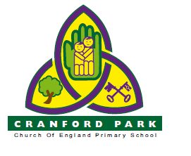
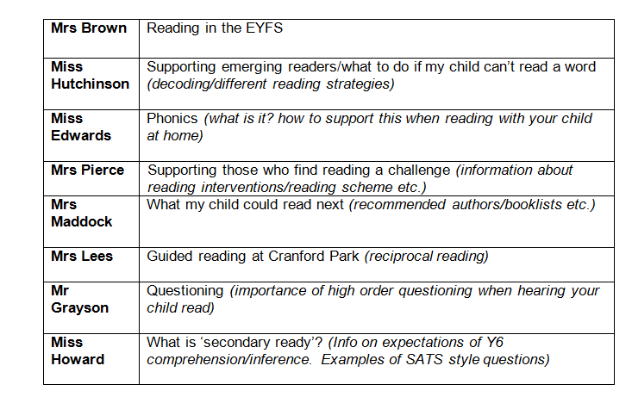
Plan
What is reading?
Reading for pleasure
How to read with my child

Slide 3
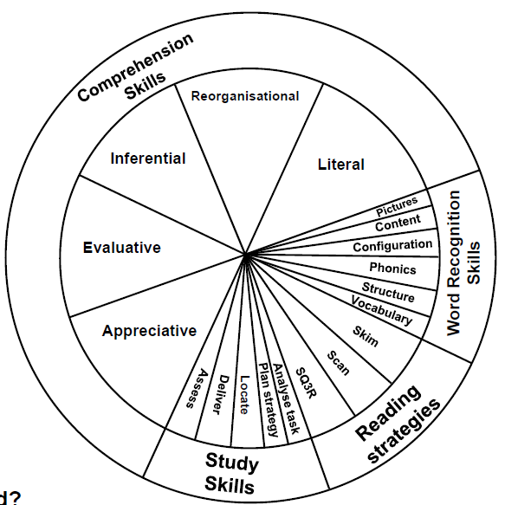
Reading
Reading: It is not a simple single skill.
It is a complex set of strategies, which will result in different outcomes.
Dyslexia International

Slide 4
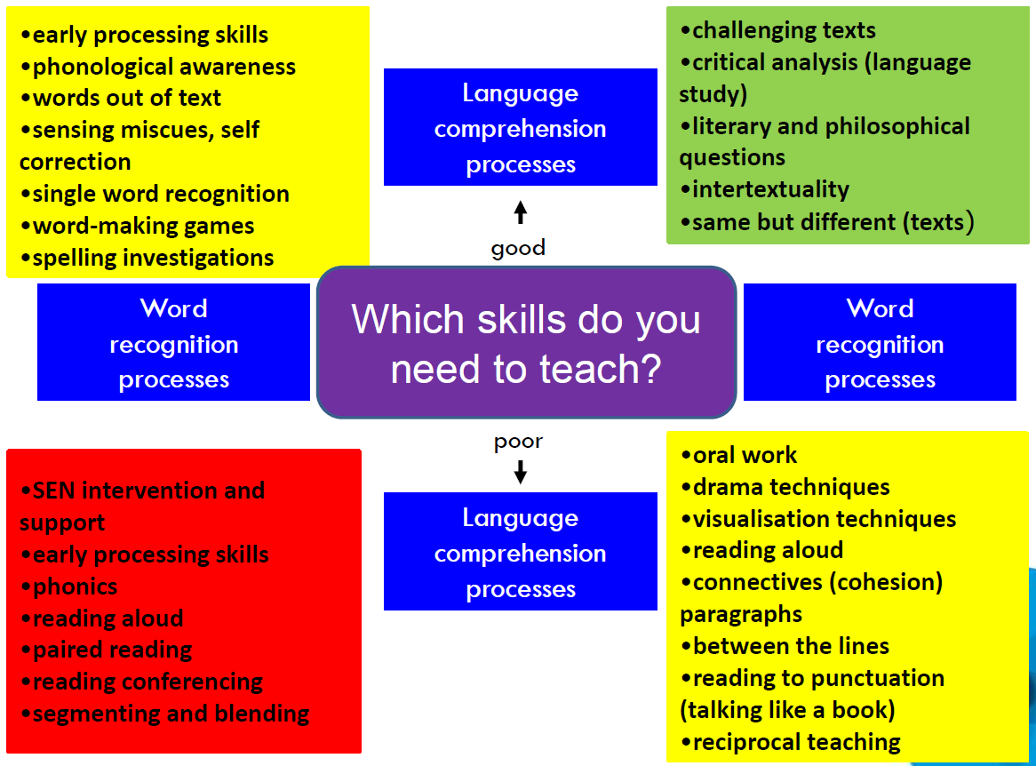

Slide 5
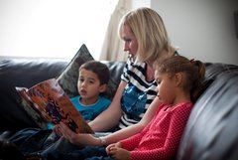
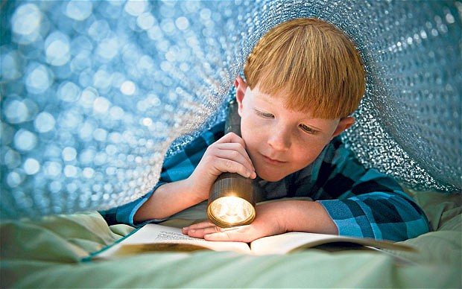
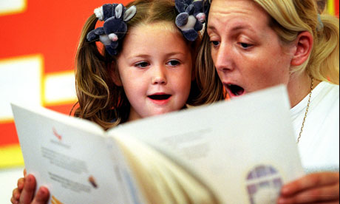

Reading for pleasure

Slide 6
Reading for pleasure
There is good evidence to suggest that young people who read for pleasure daily perform better in reading skills tests than those who never do. However, a recent survey carried out by the National Literacy Trust has indicated a decline in the amount of time children and young people spend reading for pleasure.
Education Standards Research Team, ESARD May 2012

Slide 7
Reading for pleasure
An important factor in developing reading for pleasure is providing choice - choice and interest are highly related
Parents and the home environment are essential to the early teaching of reading and fostering a love of reading; children are more likely to continue to be readers in homes where books and reading are valued
Reading for pleasure is strongly influenced by relationships between teachers and children, and children and families.
Education Standards Research Team, ESARD May 2012

Slide 8
Modelling reading
DVD

